Slide 1
Facial
Identification
By Bighnesh Lenka and Harapriya Patra

Slide 2
Overview
Our Facial Recognition Project aims to develop a comprehensive system capable of detecting human age, gender, and facial expressions from facial images. Leveraging advanced machine learning techniques and deep learning models, we are creating a versatile solution with potential applications in various domains, including security systems, personalized user experiences, and social analysis.

Slide 3
Data Collection:
We have successfully collected a diverse dataset comprising facial images from various sources.
Age, gender and emotions labels are associated with each image, providing essential ground truth data for training.
Libraries Used: PIL (Python Imaging Library), NumPy, Pandas, ZipFile

Slide 4
Dataset Overview:
Utilized two key datasets, UTKFace and CK+, for model training.
UTKFace: Diverse dataset covering a wide age range.
CK+: Focused on facial expressions, essential for emotion prediction.
Data Preprocessing:
Resized images for uniformity, optimizing for model performance.
Age: Extracted age information from UTKFace dataset labels.
Gender: Utilized gender labels provided in UTKFace.
Emotion: Employed CK+ dataset for training emotion detection models.

Slide 5
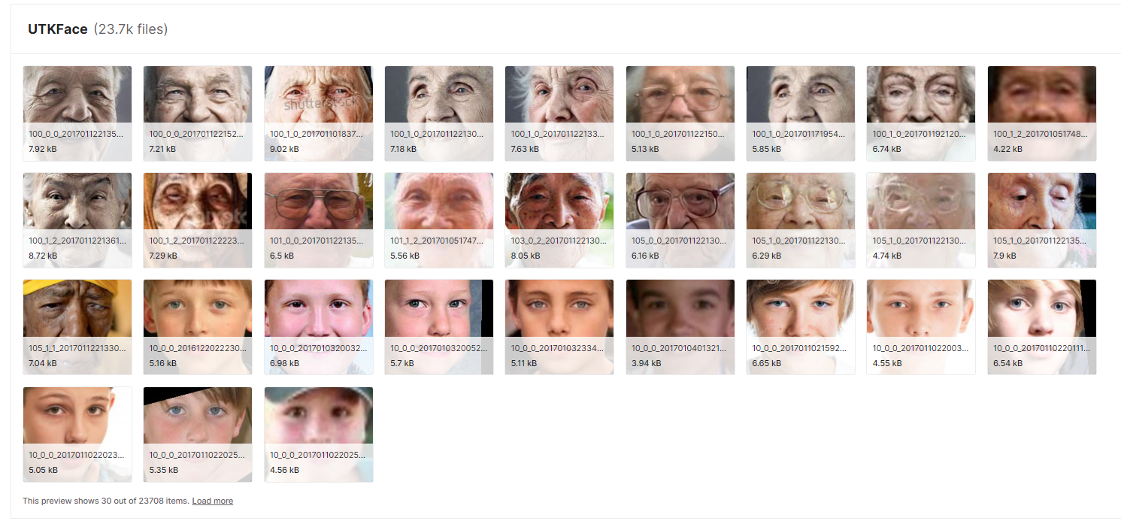

Slide 6
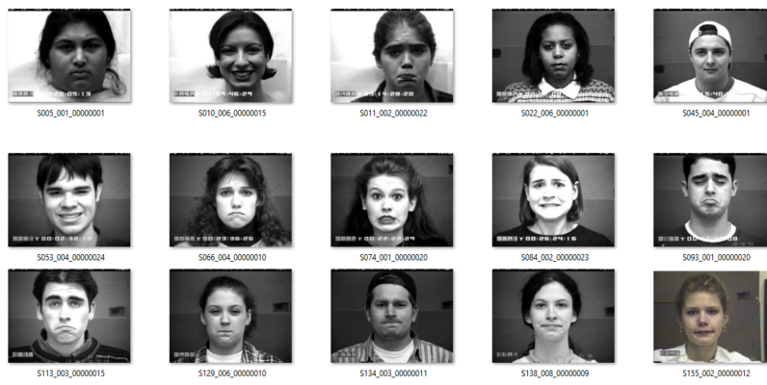

Slide 7
Exploratory Data Analysis (EDA):
Age, gender and emotion distributions in the datasets have been analyzed using visualization techniques.
EDA has provided insights into the age, gender and emotion characteristics of the dataset.
Visualization plots have been created to present the age and gender distributions effectively.
Libraries Used: NumPy, Pandas, Matplotlib, Seaborn

Slide 8
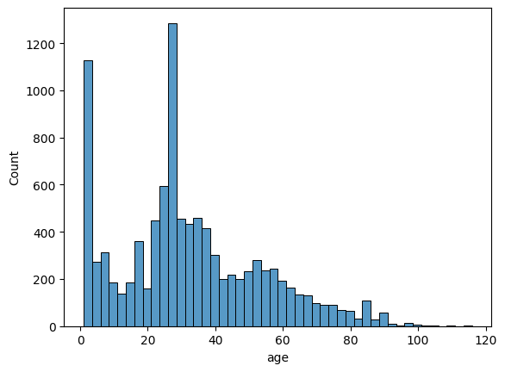

Slide 9
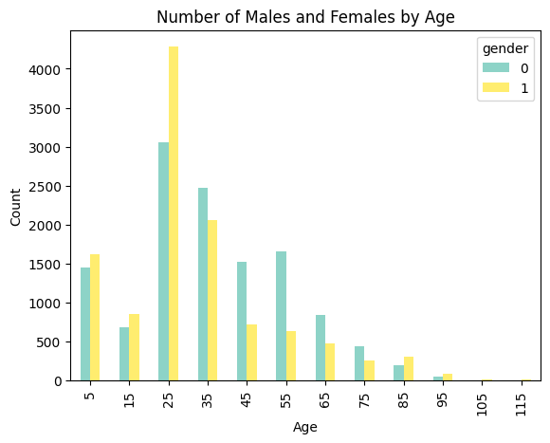
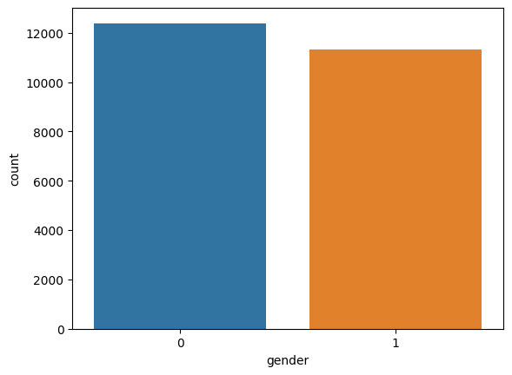

Slide 10
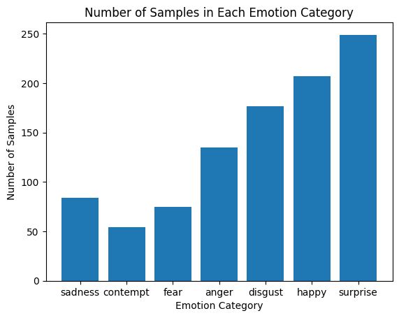

Slide 11
Creating Age Model:
A sequential neural network was constructed for age prediction with convolutional layers and average pooling for spatial reduction.
The model incorporates a GlobalAveragePooling2D layer and two dense layers (132, 7 nodes) for classification.
Utilized categorical cross entropy loss and Adam optimizer, saving the best model weights based on validation accuracy.
The model was trained for 60 epochs, monitored by ModelCheckpoint, and its architecture and training history are accessible in the provided code.

Slide 12
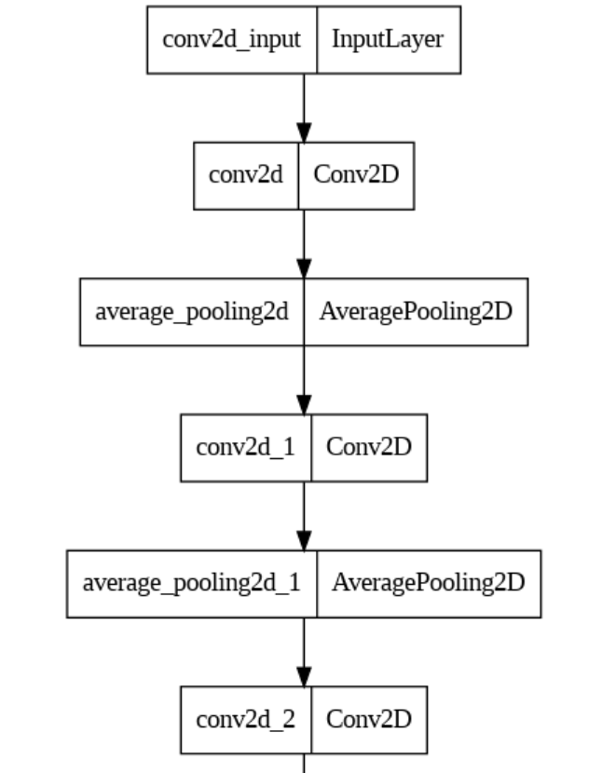
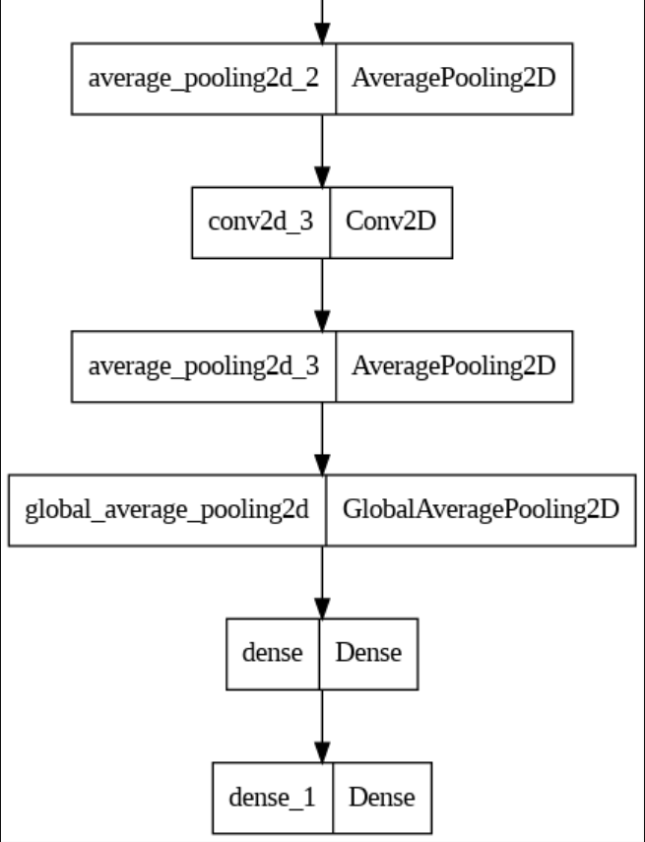

Slide 13
Creating Gender Model:
Created a gender prediction model using a convolutional neural network (CNN) with four convolutional layers (32, 64, 128, 256), dropout for regularization, and max-pooling for spatial reduction.
The model includes a dense layer with 128 nodes and a dropout layer, followed by a binary classification output layer using sigmoid activation.
Trained for 30 epochs with Adam optimizer, the model aims to predict gender from facial images and is saved using ModelCheckpoint.

Slide 14
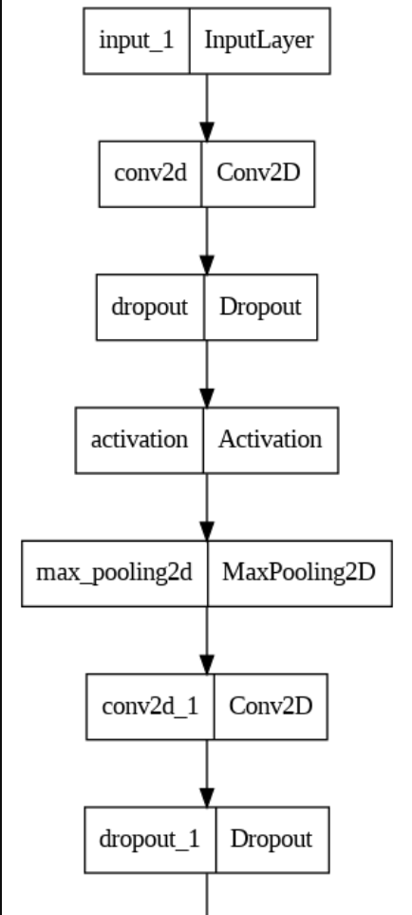
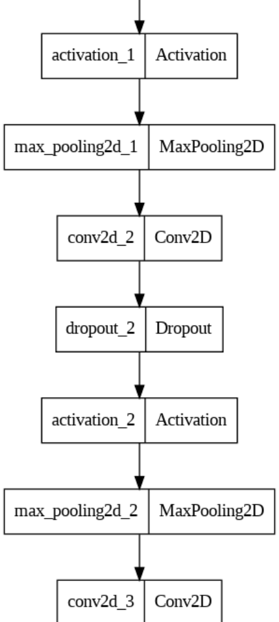
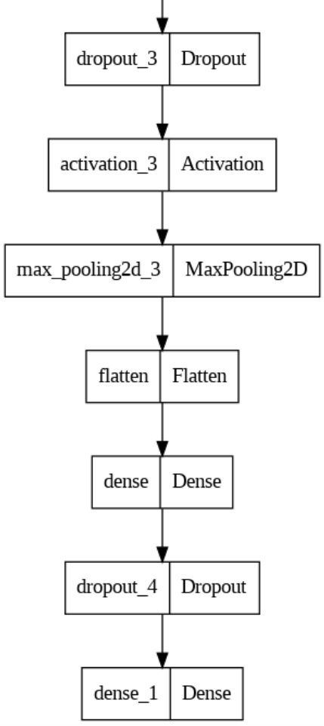

Slide 15
Creating Emotion Model:
Constructed an emotion prediction model using a convolutional neural network (CNN) with four convolutional layers (32, 64, 128, 256) and max-pooling for feature extraction.
The model includes a dense layer with 128 nodes and a softmax output layer for classifying emotions into seven categories.
Trained for 50 epochs with Adam optimizer, the model is saved based on the best validation loss using ModelCheckpoint.

Slide 17
Models integration:
Finally implemented all three model together to detect age, gender and emotion of the face.
We used openCV haarcascade for detection of the face.
Then we performed the required processing on the detected face(s).
Then Finally implemented all three model together to predict age, gender and emotion of the face(s) with a visual representation.

Slide 18
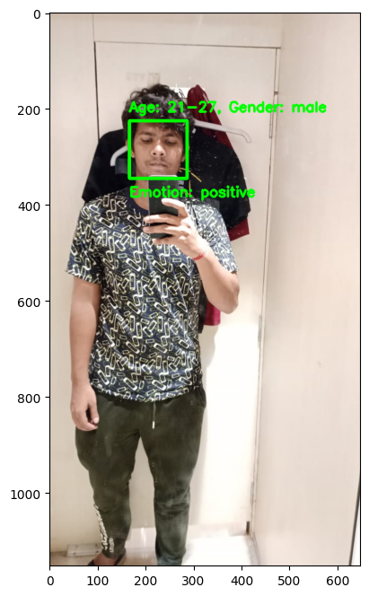
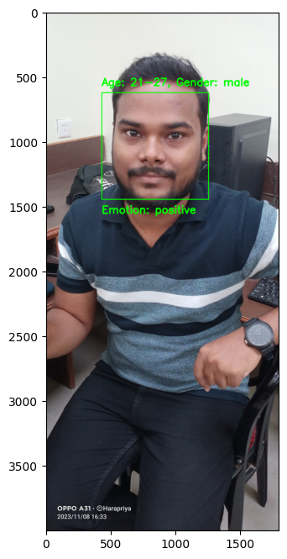

Slide 19


Slide 20
Thank You

